Slide 1

Scryfall API Portability Assistant
IMT 542
Samuel Lee

Slide 2
What is Scryfall?

Slide 3
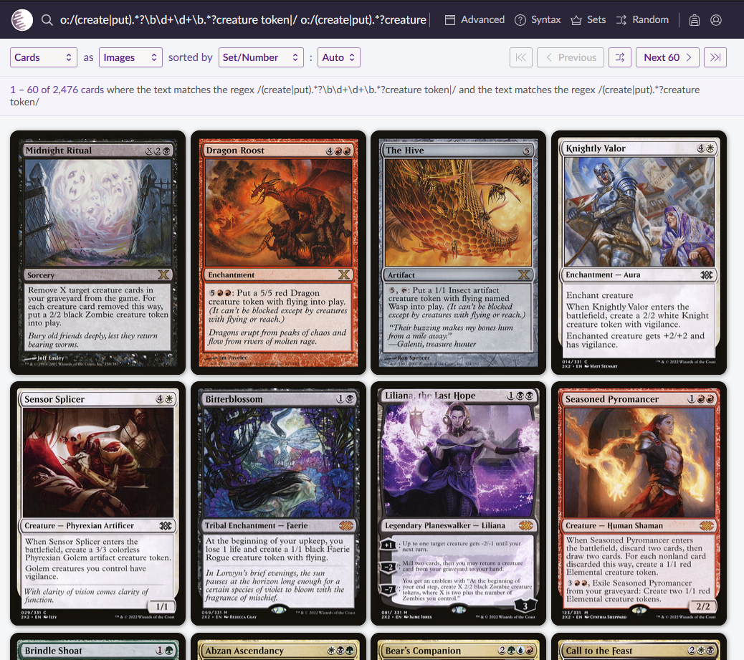
Powerful Magic: The Gathering online card search tool

Slide 4
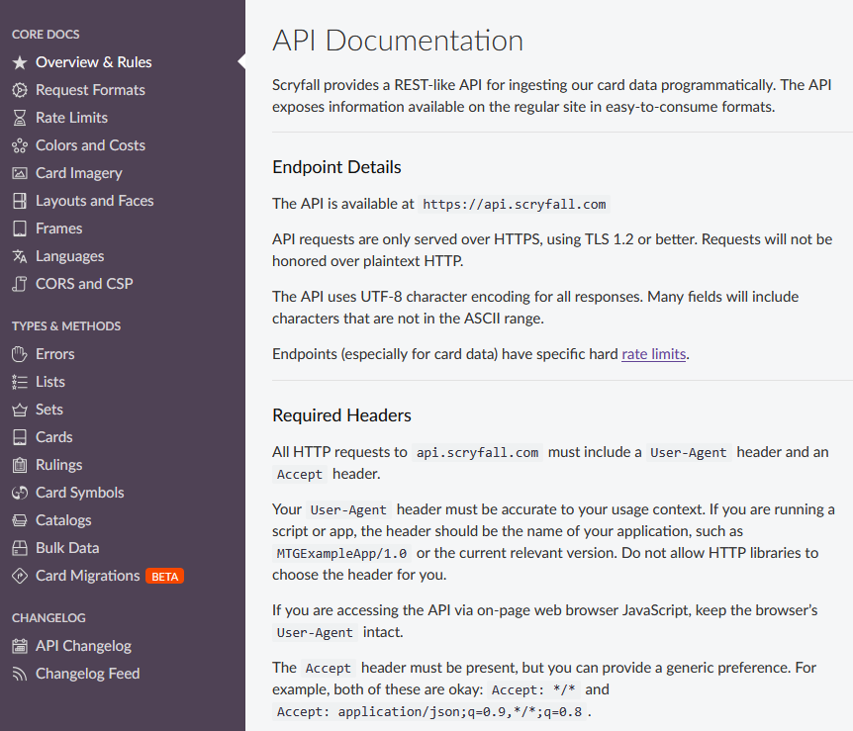
REST-like API to programmatically ingest card data

Slide 5
Scryfall is great, but…
Default search is difficult to export data out of
Requires technical knowledge to export data via API
Some limited flexibility with the shape of exported data

Slide 6
The API Portability Assistant is for:
Anyone interested in Magic cards, including:
Players
Collectors
Data analysts
Designers
They can utilize the API Portability Assistant to:
Access bulk card data
Selectively export the data they wish to retrieve

Slide 7
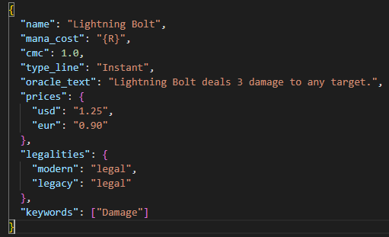
F: consistent field names and vocabularies, persistent identifiers such as UUID and oracle_id. A: Bulk data directly downloadable, otherwise accessible via API endpoint (HTTPS) I: Machine-readable format, but not formal schema/ontology R: Limited metadata

Slide 8
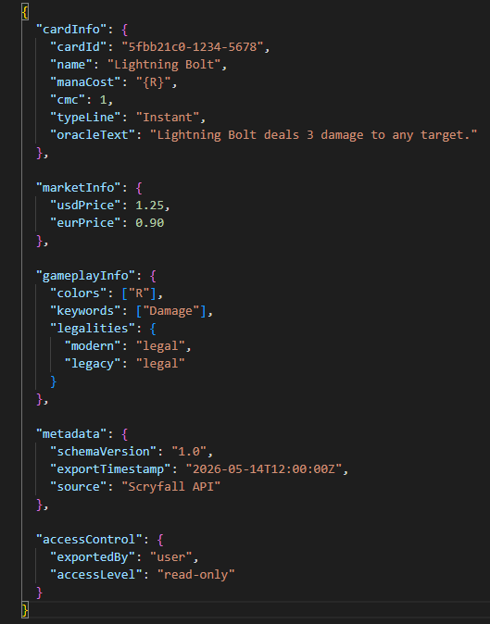
Inclusion of additional internal fields, separation of fields, and metadata

Slide 9
Data Quality Assurance
Control in the schema:
No duplicate cardId values
Numeric datatypes
Required fields
Consistency in null handling
Schema versioning
Performance:
Single card queries
Search queries
Server cold start
Dataset export

